Slide 1
Inversion – recovery of tissue properties

Slide 2
Key ideas
Light emitted by a light source interacts with the interior of a tissue
Through these interactions the spectral composition of light is altered
The remitted spectrum depends on the internal structure and composition of the tissue and in this way encodes its properties
If this encoding is understood, it should be possible to deduce the structure and composition of the tissue from its colour

Slide 3
Key ideas
Disease processes often change the tissue structure and thus the observed colouration
Colour is used in diagnosis and assessment of tissues
The understanding of the image formation process enables us to decipher the colour encoding of tissue properties

Slide 4
Forward and inverse mapping
f = P → I
Forward
Parameters
Image values
p ∈ P
i ∈ I
f ⁻¹ : I → P
Inverse

Slide 5
Forward mapping = building a model
Model specifies the relationship between parameters P to be recovered later and the corresponding image values I.
To build the model we have to know
  Parameters (“ground truth”)
  Corresponding image values
  (not necessarily the processes linking the two)

Slide 6
Building a model – source of parameters
Physical experiments I
  Imaging known quantities of fluorescent compounds, absorbing agents, scattering substances etc
  Results in quantitative model

Slide 7
Building a model – source of parameters
Physical experiments II
  Imaging objects of interest with known relative differences (of the kind “more” or “less”)
  Results in relative model

Slide 8
Building a model – source of parameters
Theoretical predictions
  Predicting (normally by computation) image values from known parameter values
  Results in theoretical model

Slide 9
Building a model – model representation
There are many types of models, the most common being
  Explicit (a set of related touples)
  Statistical (equations with coefficients derived by training, e.g. regression models)
  Functional (equations specifying directly relationship between parameters and image values)
  Abstract models (particularly constructed using machine learning techniques, e.g. neural networks, decision trees, Bayesian networks, Support Vector Machines, etc)

Slide 10
Building a model – common problems
Errors
Measurement uncertainty (both in the ground truth and in the image)
Insufficient number of training data (under-determined model)
Training data not spanning the entire range of cases (potential for overfitting)
Unknown parameters / quantities
Ill-conditioned model (relationships between parameters and image values are not unique)

Slide 11
Model inversion (analysis)
f ⁻¹ : I → P
Parameters
Image values
p ∈ P
i ∈ I
Given image values derive the “real world” parameter values (e.g. concentrations of absorbers, quantities of fluorophores, tissue properties) using the relationships encoded in the model.

Slide 12
Model inversion - methods
Inversion methods depend on the type of model. Examples:
Explicit
  Nearest neighbour search, k-nearest neighbours search
Statistical
  Least squares, linear regression, partial least squares regression
Functional
  Algebraic derivation of the inverse solution
Machine learning
  Application of the trained model

Slide 13

Simple examples

Slide 14
Modelling skin reflectance: theoretical model

Slide 15
Optical model of the normal skin
Based on physics of image formation
Stratum Corneum
Diffusion
Absorption
Epidermis
Forward scatter
Absorption
Papillary dermis
Backscatter
Forward scatter
Reticular dermis

Slide 16


Optical model of the normal skin
Incident light
Stratum Corneum
Epidermis
Papillary dermis
Reticular dermis

Slide 17
Optical model of the normal skin
R
Incident light
B
G

Slide 18
Optical model of the normal skin
R
Incident light
B
G

Slide 19
Forward mapping (prediction / training)
Forward model of image formation in abstraction
∫
I₀(x,λ)
R(x,λ)
F_{n}(λ)
Q(λ)
dλ
i_{n}(x) =
Parameters
f = a ° b : P → I
Image values
∀
p ∈ P
i ∈ I
a : P → Λ
b : Λ → I
Spectra
λ ∈ Λ

Slide 20
Forward mapping algorithm
given
incident light
absorption and scatter coefficients for all the components
the spatial arrangement of the components
for all concentrations and thicknesses of parameter p₁
for all concentrations and thicknesses of parameter p₂
. . .
for all concentrations and thicknesses of parameter p_{K}
compute λ = a( p₁, p₂, …, p_{K} )
Physics theory of light propagation in matter
Kubelka-Munk or Monte Carlo
convolve each λ with a set of filter response functions (RGB)
Constants
Parameters
Spectra
Image values

Slide 21
Optical model of the normal skin
R
Haemoglobin concentration
Melanin concentration
B
G

Slide 22
Melanin in the dermis
R
Normal skin
Melanin in the dermis
Melanoma
B
G

Slide 23
Mapping between the variable tissue parameters and colours
R
Haemoglobin concentration
Papillary
Dermis thickness
Melanin concentration
B
G

Slide 24
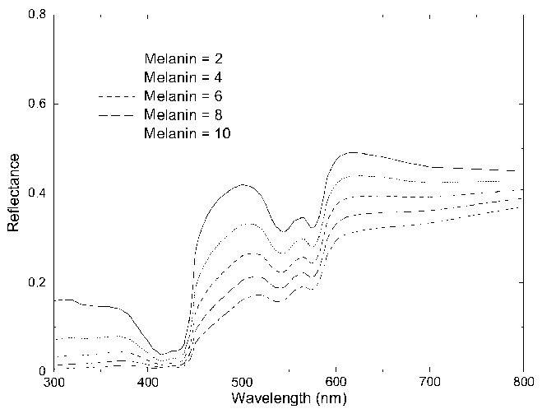
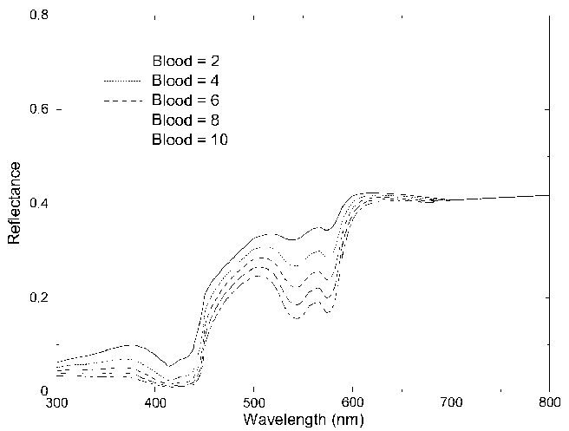
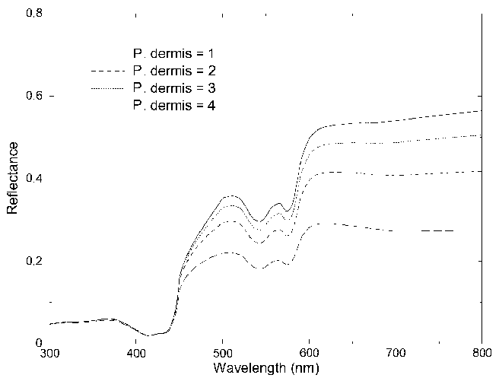
From parameters to spectra

Slide 25
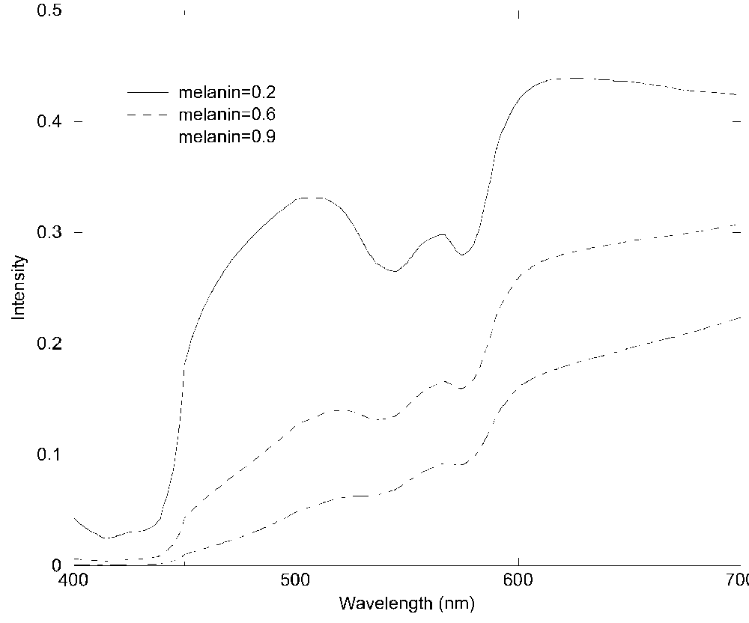
From parameters to spectra

Slide 26
From spectra to colours

Slide 27
From colour to parameters (inversion)
R
Haemoglobin
H
M
Papillary
dermis
Melanin
B
G

Slide 28
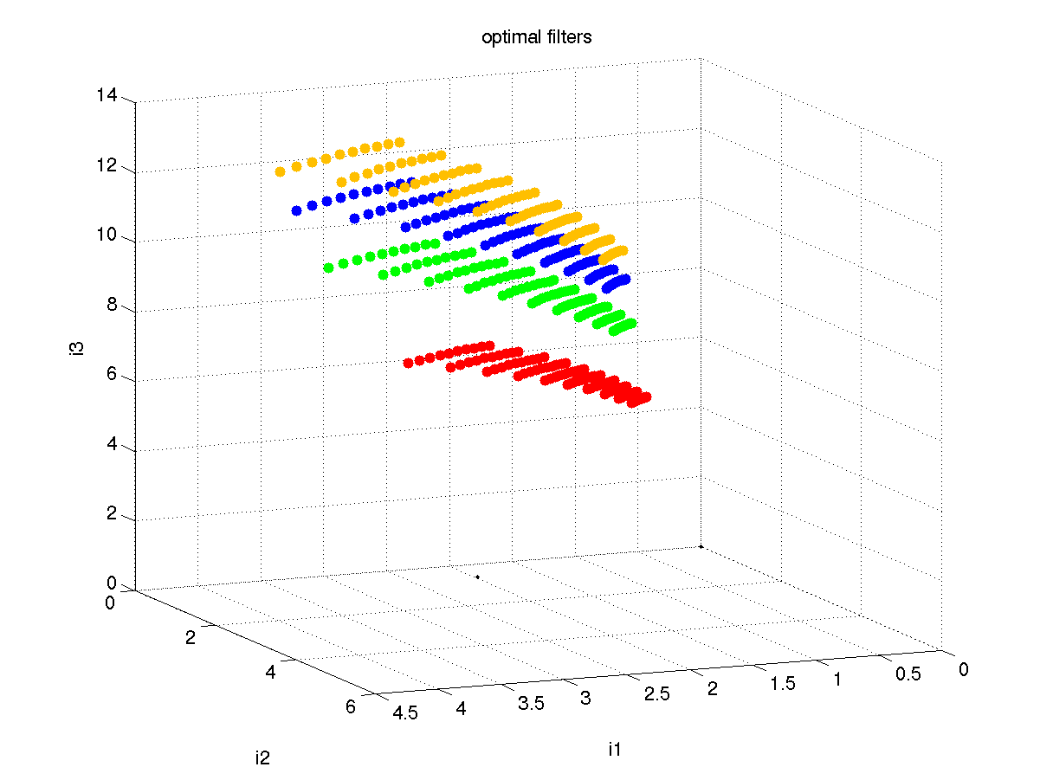
The model of normal skin colours
CHANGE

Slide 29
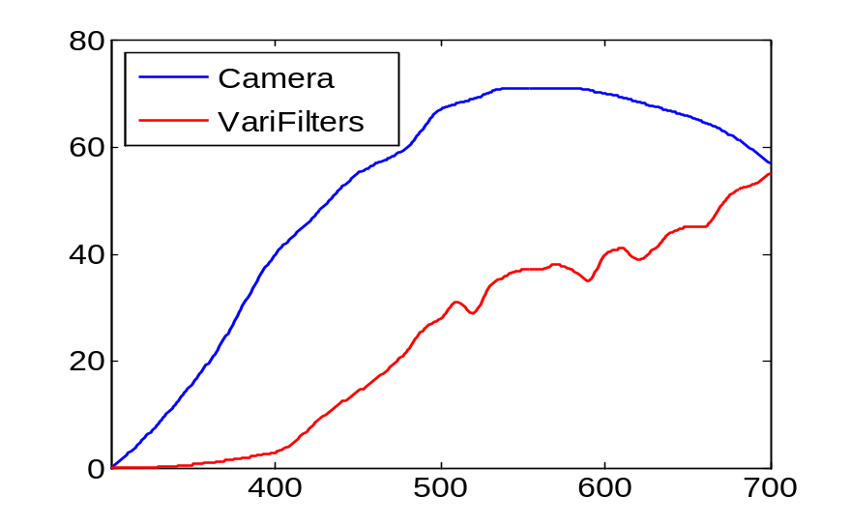
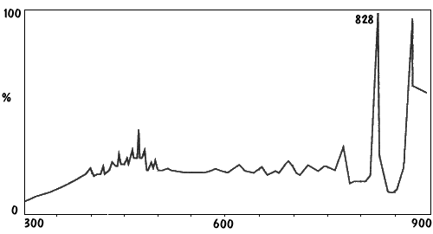
Image formation model
Imaging system
QE
Image values recorded by the imaging device are affected by optical properties of the device, such as its quantum efficiency Q(λ).
Transmittance
Incident light
Xenon
In practice, the measured reflectance R(x,λ) depends also on the spatial and spectral properties of the incident light I₀(x,λ).

Slide 30
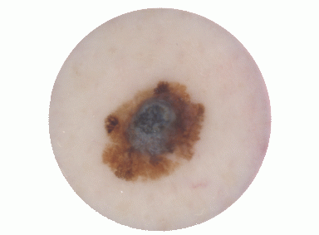
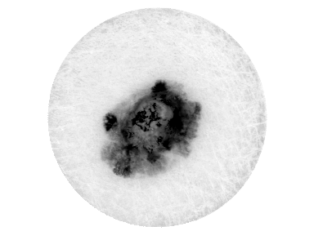
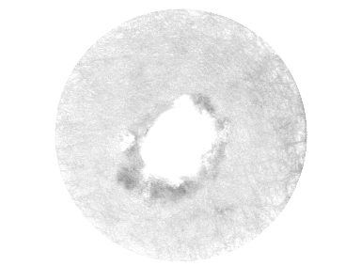
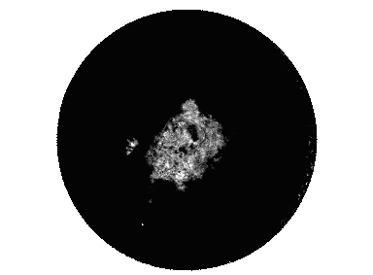
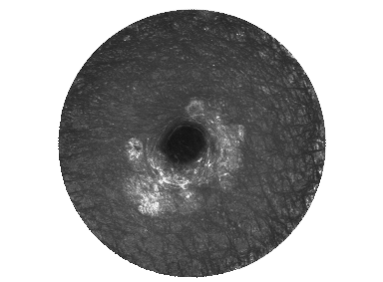
Parametric maps: Melanoma
CHANGE
Melanin
Blood
Dermal melanin
Collagen

Slide 31
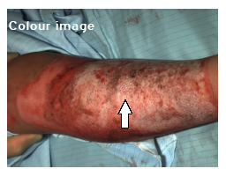
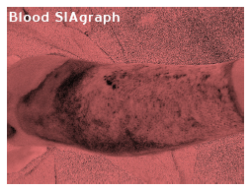
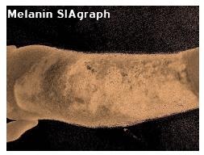
Assessment of burns

Slide 32
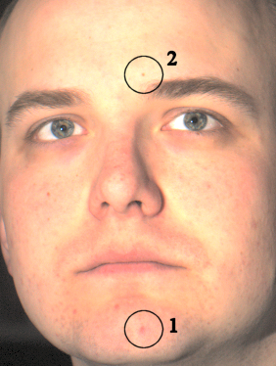
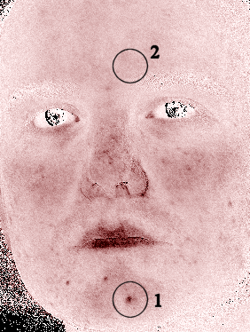
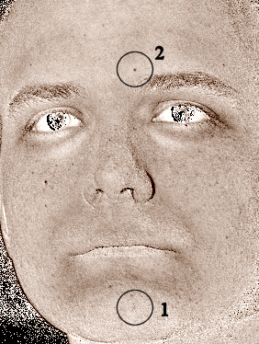
Colour image analysis in skin cosmetics
Non –contact imaging
Colour image
Parametric map of blood
Parametric map of melanin

Slide 33


